Slide 1


Believe Okolie
14/12/2022

Slide 2

Outline
Executive Summary
Introduction
Methodology
Results
Conclusion
Appendix

Slide 3
Executive Summary
Summary of methodologies
- Data Collection through API
- Data Collection with Web Scrapping
- Data Wrangling
- Exploratory Data Analysis with SQL
- Exploratory Data Analysis with Data Visualization
- Interactive Visual Analytics with Folium
- Machine Learning Prediction
Summary of all results
- Exploratory Data Analysis Results
- Interactive Analytics in Screenshots
- Predictive Analytics Results

Slide 4
Introduction
Project background and context
Space X advertises Falcon9 rocket launches with cost of $62million. Other providers cost over $165 million each, this large variation is because Space X can reuse the first stage. Therefore if we can determine if the first stage will land, we can determine the cost of the launch. This information can be used if an alternate company wants to bid against Space X for a rocket launch. The aim of this project is to create a machine leaning pipeline if the first stage will land successfully.
Problems you want to find answers
- What factors determine if the rocket will land successfully
- The interaction amongst various features that determine the success rate of a successful landing
- What operating conditions needs to be in place to ensure a successful landing

Slide 5

Section 1

Slide 6
Methodology
Executive Summary
Data collection methodology:
Describe how data was collected
Perform data wrangling
Describe how data was processed
Perform exploratory data analysis (EDA) using visualization and SQL
Perform interactive visual analytics using Folium and Plotly Dash
Perform predictive analysis using classification models
How to build, tune, evaluate classification models

Slide 7
Data Collection
- Data was collected using a get request to the Space X API
- The content was decoded into a Json, using a .json() function call and turn it into a pandas dataframe using a .json_normalize().
- Data was cleaned, checked for missing values and replacing the missing values were necessary
- In addition, we performed web scrapping from Wikipedia for Falcon9 launches record with BeautifulSoup
- The objective was to extract the launch records as a HTML table, parse the table and convert it to a pandas dataframe for analysis.

Slide 8
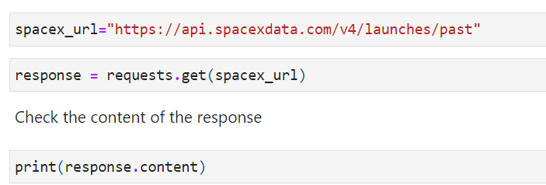
Data Collection – SpaceX API
The get request was used to collect data from the Space X API, cleaned the data and performed data wrangling and formatting.
The link to the notebook is: https://github.com/Believened/IBM_Capstone_Project/blob/main/Data%20Collection%20API.ipynb

Slide 9
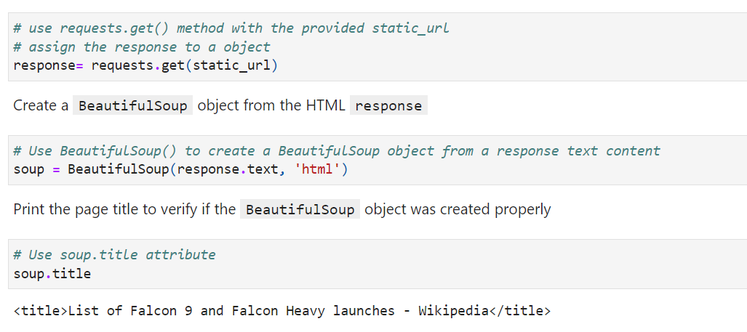
Data Collection - Scraping
We applied Webscrapping to gather data for Falcon9 launch records on Wikipedia with BeautifulSoup
The table was parsed and converted into a pandas dataframe.
The link to the notebook is: https://github.com/Believened/IBM_Capstone_Project/blob/main/Data%20Collection%20with%20Web%20Scraping.ipynb

Slide 10
Data Wrangling
Exploratory analysis was performed on the data and training labels were determine.
The number of launches was calculated at each site, and the occurrence of each orbit
A landing outcome label was created from the outcome column and exported the results to a csv
The link to the notebook is:
https://github.com/Believened/IBM_Capstone_Project/blob/main/EDA.ipynb

Slide 11
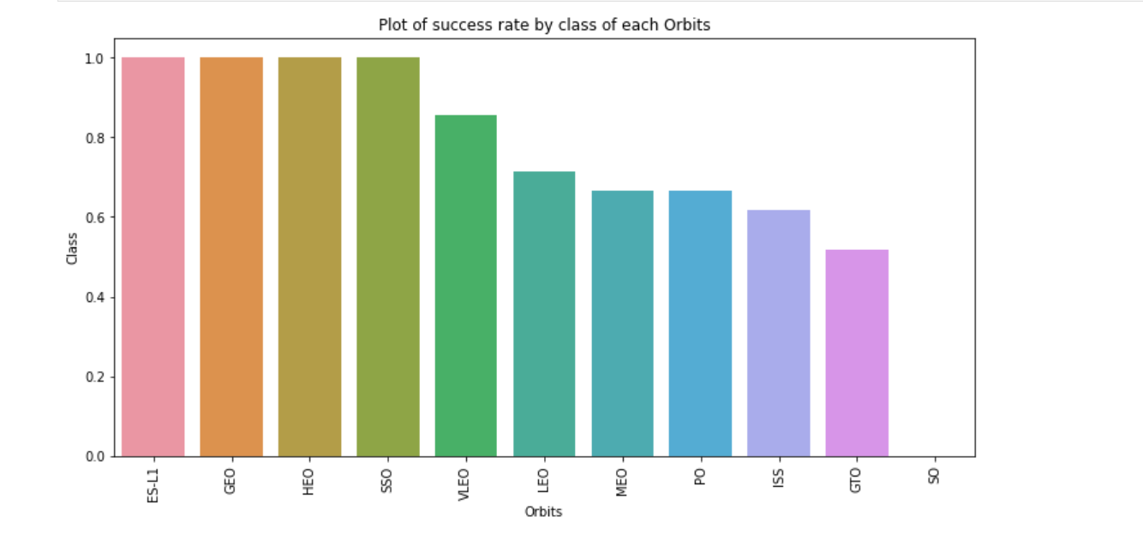
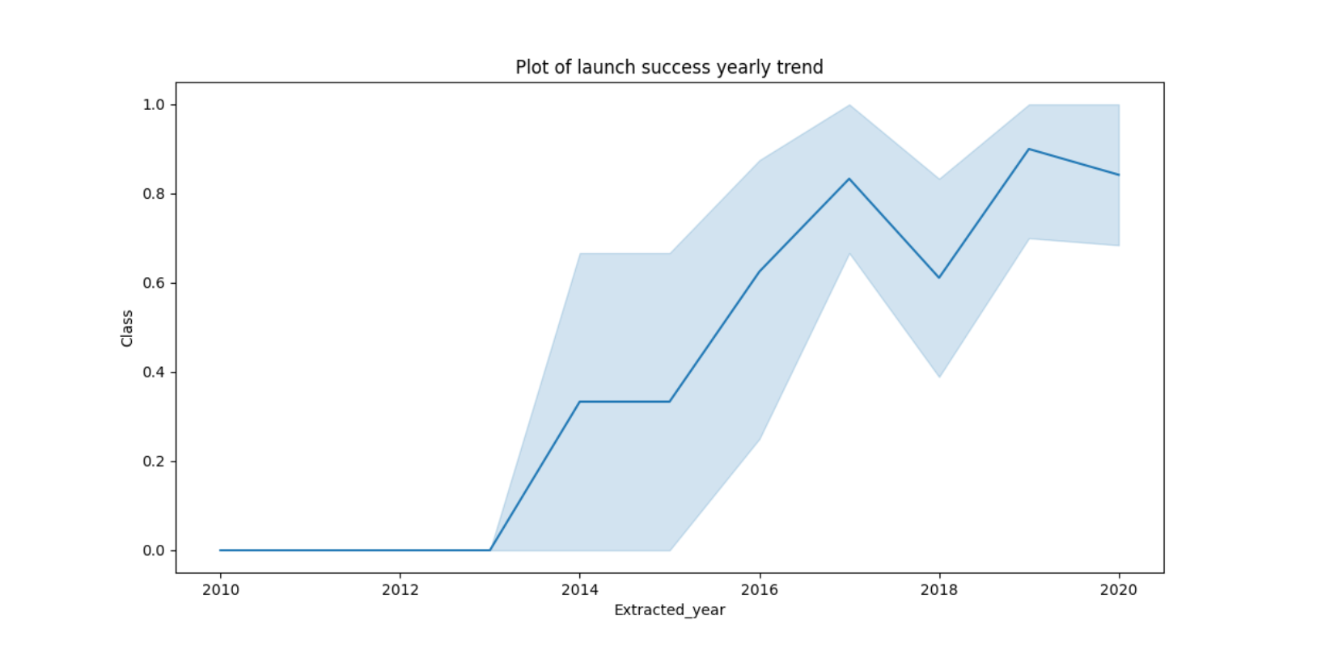
EDA with Data Visualization
We explored the data by visualizing the relationship between, flight number and launch site, success rate of each orbit type, flight number and orbit type, the launch success yearly trend
The bar chart was used to show the success rate of each orbit type because it will display categorically for each orbit type, the success rate.
The line graph was used to show the yearly trend of success as it is better suited and makes it easier to see any slight change
The link to the notebook: https://github.com/Believened/IBM_Capstone_Project/blob/main/EDA%20with%20Data%20Visualization.ipynb

Slide 12
EDA with SQL
The Space X dataset was loaded into IBM-DB2 Database and connected to the notebook
Exploratory data analysis was done using SQL to get insights from the data. Queries was written to find out the following
- The names of the unique launch sites
- The total payload mass carried by booster launched by NASA
- The average payload mass carried by booster version F9 v1.1
- The total number of successful and failure outcomes
- The failed landing outcomes in drone ship, their booster version and launch site names
The link to the notebook:
https://github.com/Believened/IBM_Capstone_Project/blob/main/EDA%20with%20SQL.ipynb

Slide 13
Build an Interactive Map with Folium
All launch sites were marked and objects such as markers, lines and circles to mark the success and failure of launches for each site on the folium map
The feature launch outcomes (failure and success) was assigned to class 0 and 1, 0 for failure and 1 for success.
Using the color-labeled marker clusters, we identified which launch sites have relatively high success rate
The distance between launch sites and its proximities was calculated. We answered some questions for instance:
- Are launch site near railways, highways and coastlines
- Do launch sites keep certain distance away from cities

Slide 14
Build a Dashboard with Plotly Dash
An interactive dashboard with Plotly dash was built
Pie charts showing total launches by certain sites was ploted
A scatter graph showing the relationship with outcome and payload mass(kg) for the different booster version
The link to the notebook is: https://github.com/Believened/IBM_Capstone_Project/blob/main/dash_interactivity.py

Slide 15
Predictive Analysis (Classification)
The data was loaded and transformed using pandas and numpy, and split the data into training and test sets
Different machine learning models was built and different hyperparameters tuned using GridSearchCV
Accuracy was used as a metric for our model, the model was improved using feature engineering and algorithm tuning
The best performing classification model was found
The link to the notebook is:
https://github.com/Believened/IBM_Capstone_Project/blob/main/SpaceX_Machine_Learning_Prediction_Part_5.jupyterlite.ipynb

Slide 16
Results
Exploratory data analysis results
Interactive analytics demo in screenshots
Predictive analysis results

Slide 17

Section 2

Slide 18
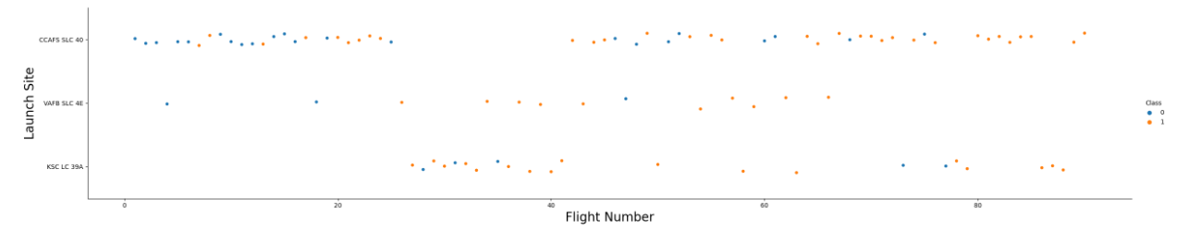
Flight Number vs. Launch Site
From the plot below, we find that the higher the flight amount on a launch site, the greater the success rate at the launch site

Slide 19
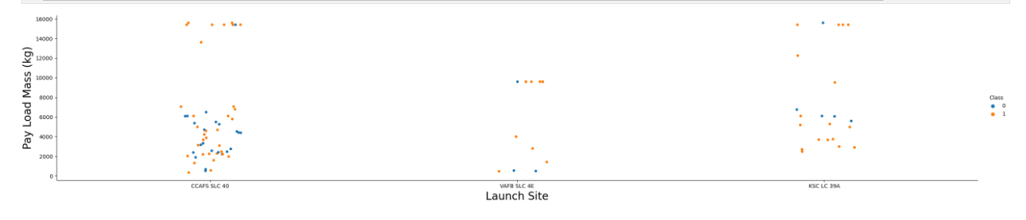
Payload vs. Launch Site
From the visualizations, insights was drawn for launch site CCAFS SLC 40, the higher the payload mass, the higher the success rate.

Slide 20
Success Rate vs. Orbit Type
From the plot, we can see that ES-L1, GEO, HEO, SSO, and VLEO had the most success rate

Slide 21
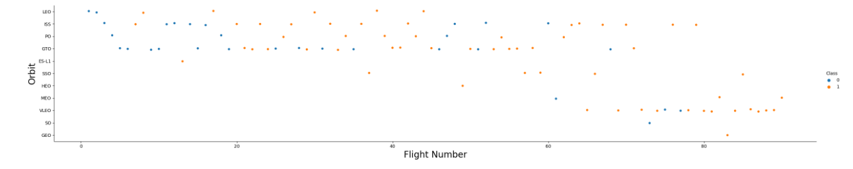
Flight Number vs. Orbit Type
The below shows the Flight Number against the orbit type, We observe that in the LEO orbit, success is related to the number of flights whereas in the GTO orbit, there is no relationship between flight number and orbit.

Slide 22
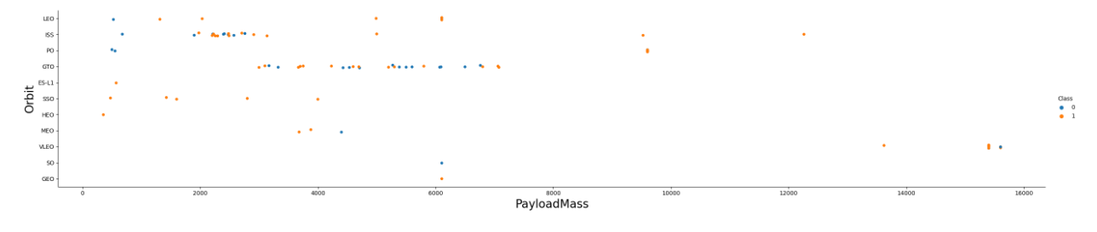
Payload vs. Orbit Type
We can observe that with heavy pay loads the successful landing are more for PO, ISS and LEO orbits

Slide 23
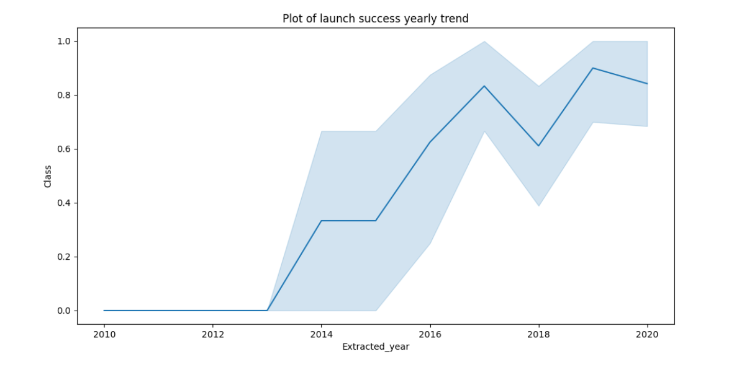
Launch Success Yearly Trend
From the visualization, it can be seen that the success rate kept on increasing from 2013 till 2020

Slide 24
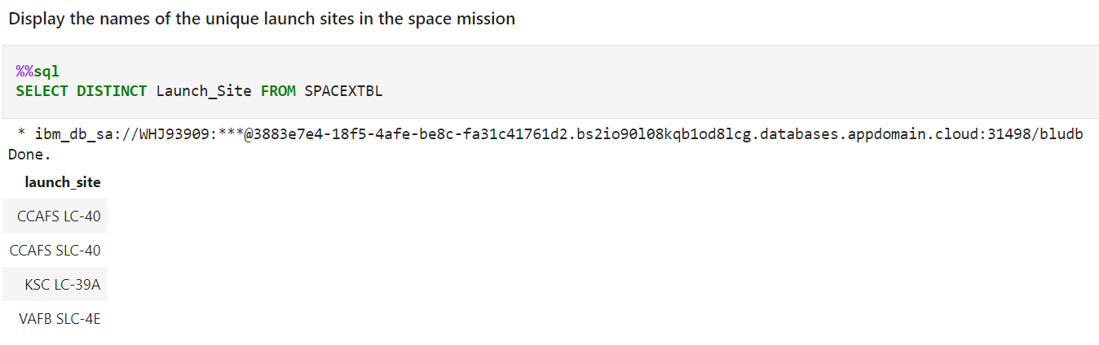
All Launch Site Names
The DISTINCT keyword was used to display the unique launch sites from the Space X data which was loaded into the table SPACEXTBL as seen below.

Slide 25
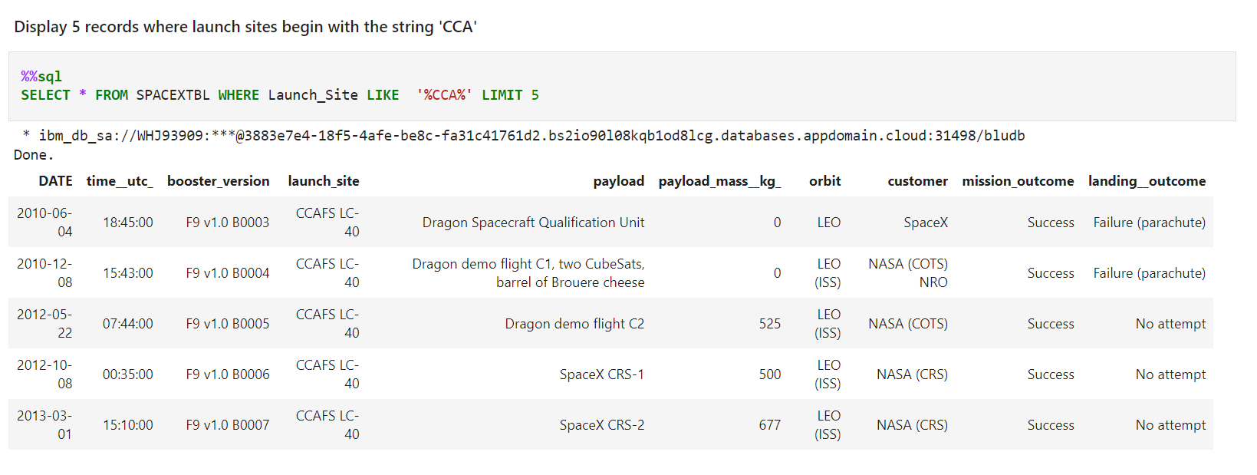
Launch Site Names Begin with 'CCA'
We used the LIMIT and LIKE keyword to display 5 records where launch sites began with `CCA`

Slide 26
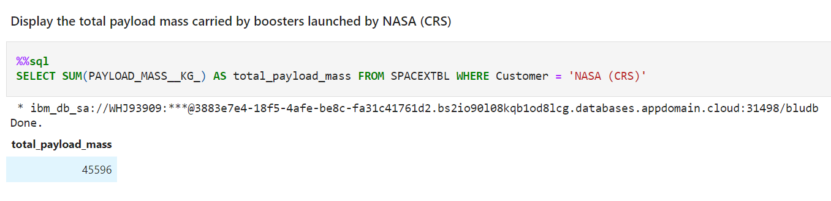
Total Payload Mass
The total payload mass carried by boosters from NASA was calculated to be 45596 using the query below;

Slide 27
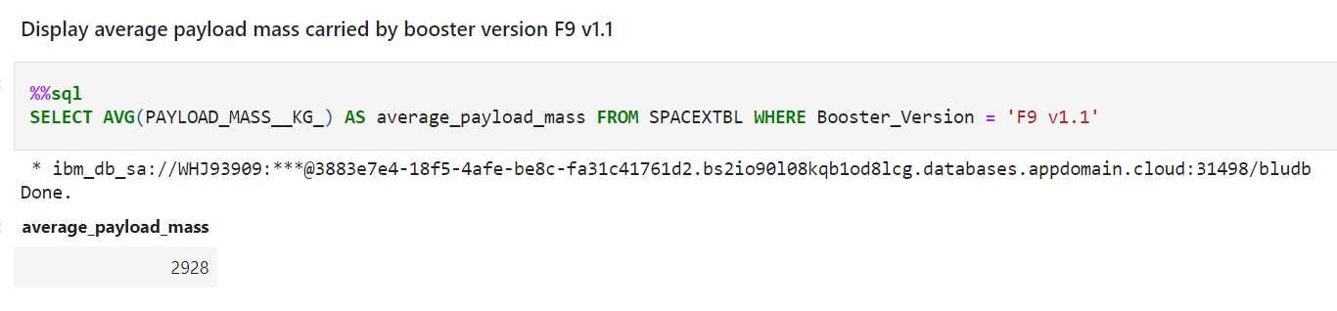
Average Payload Mass by F9 V1.1
The average payload mass carried by booster version F9 v1.1 was calculated using the query below

Slide 28
First Successful Ground Landing Date
The date of the first successful landing outcome on ground pad was also inquired

Slide 29
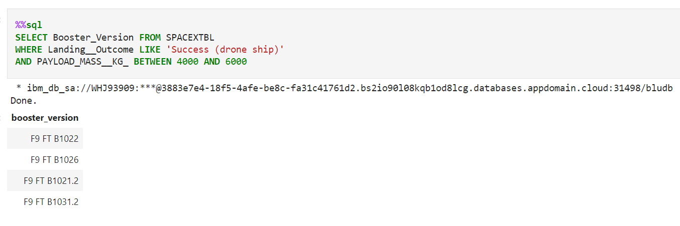
Successful Drone Ship Landing with Payload between 4000 and 6000
The names of boosters which have successfully landed on drone ship and had payload mass greater than 4000 but less than 6000 was listed using the Keyword BETWEEN.

Slide 30
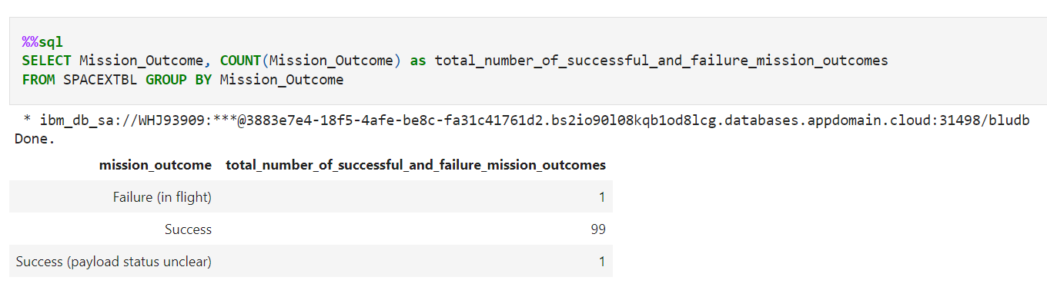
Total Number of Successful and Failure Mission Outcomes
Calculating the total number of successful and failure mission outcomes;

Slide 31
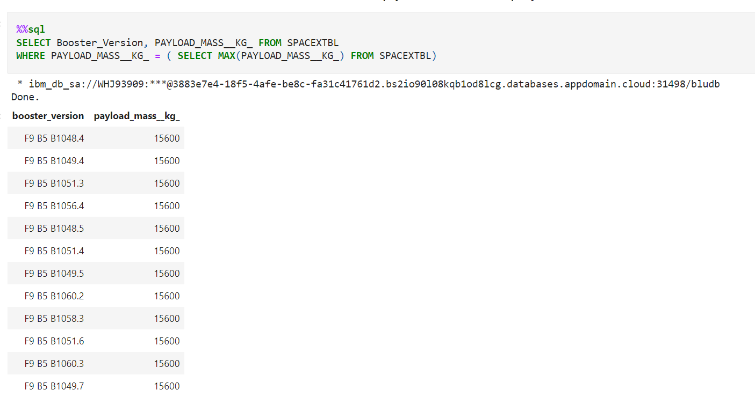
Boosters Carried Maximum Payload
The query below enabled us to list the names of the booster which have carried the maximum payload mass using a subquery

Slide 32
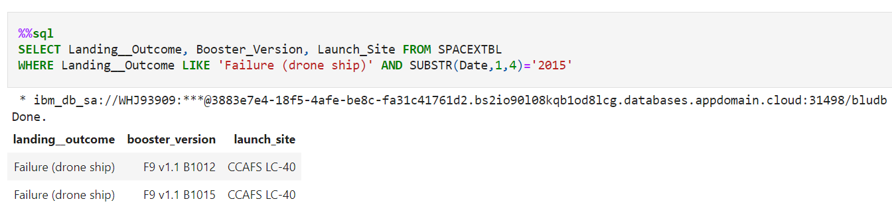
2015 Launch Records
Listing the failed landing_outcomes in drone ship, their booster versions, and launch site names for in year 2015 using the WHERE, LIKE and SUBSTR clause

Slide 33
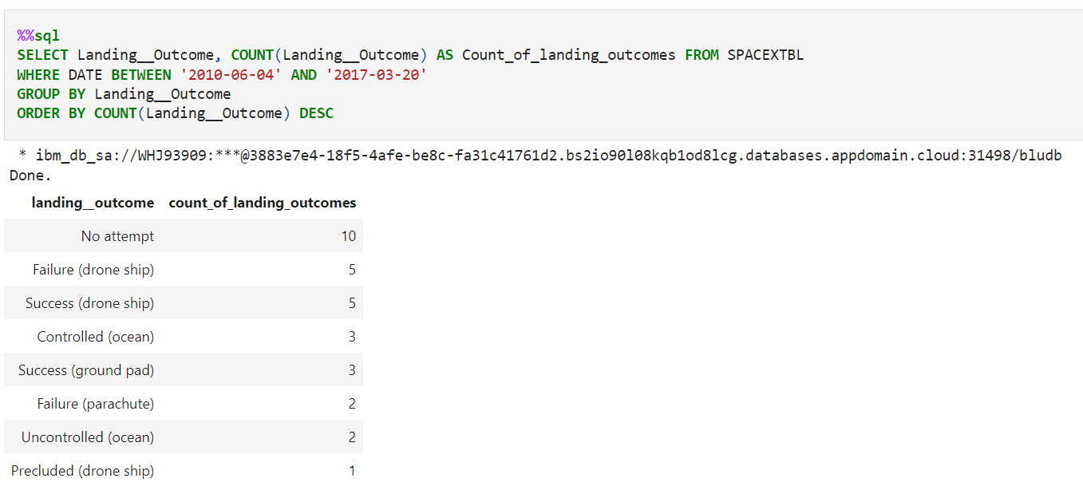
Rank Landing Outcomes Between 2010-06-04 and 2017-03-20
The count of landing outcomes (such as Failure (drone ship) or Success (ground pad)) between the date 2010-06-04 and 2017-03-20, and it was ranked in descending order using keywords ORDER BY DESC. The GROUP BY was used to group the landing outcomes

Slide 34

Section 3

Slide 35
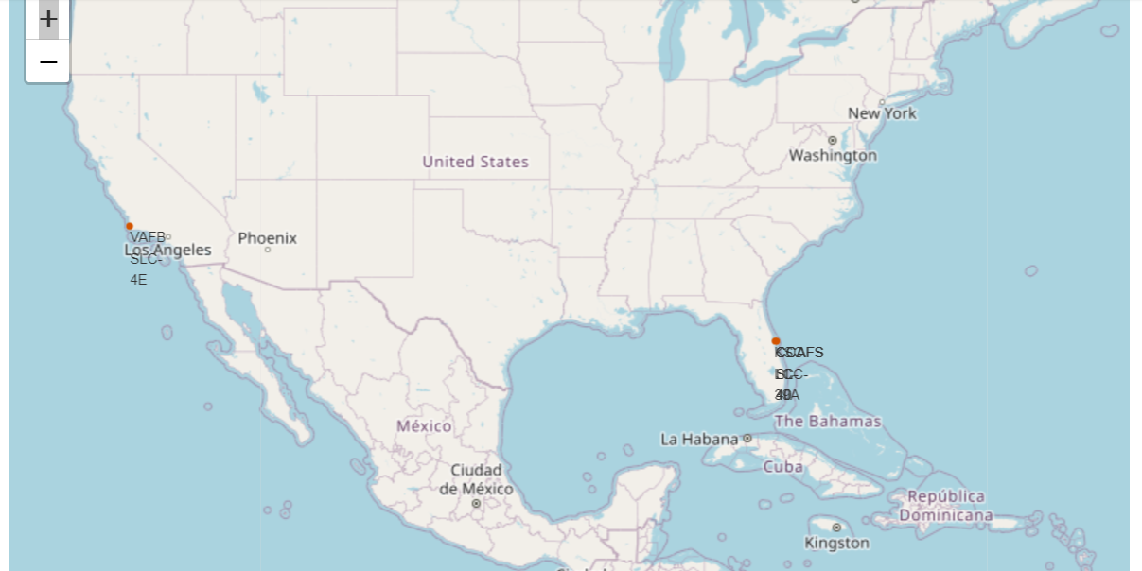
Folium Map displaying all Launch Sites
From the visual below we can observe that the launch sites are in the United States of America coast; Florida and California

Slide 36
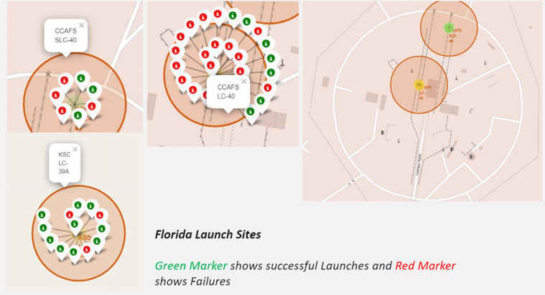
Launch Sites shown with colored Markers

Slide 37
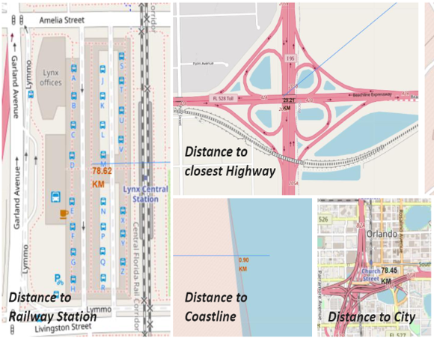
Launch Sites distance to Landmarks

Slide 38

Section 4

Slide 39
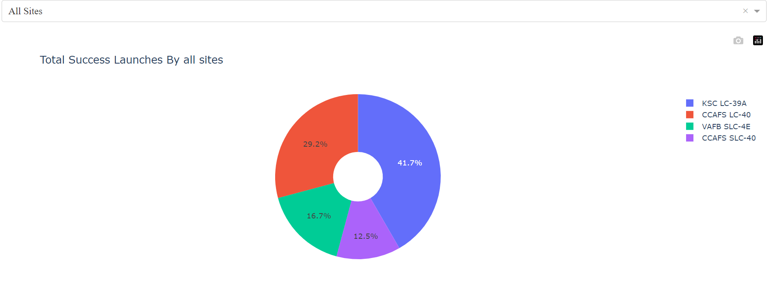
Pie Chart showing success rate by each Launch Sites
We can see from the Pie chart shown below that KSC LC-39A had the most successful launches from all launch sites

Slide 40
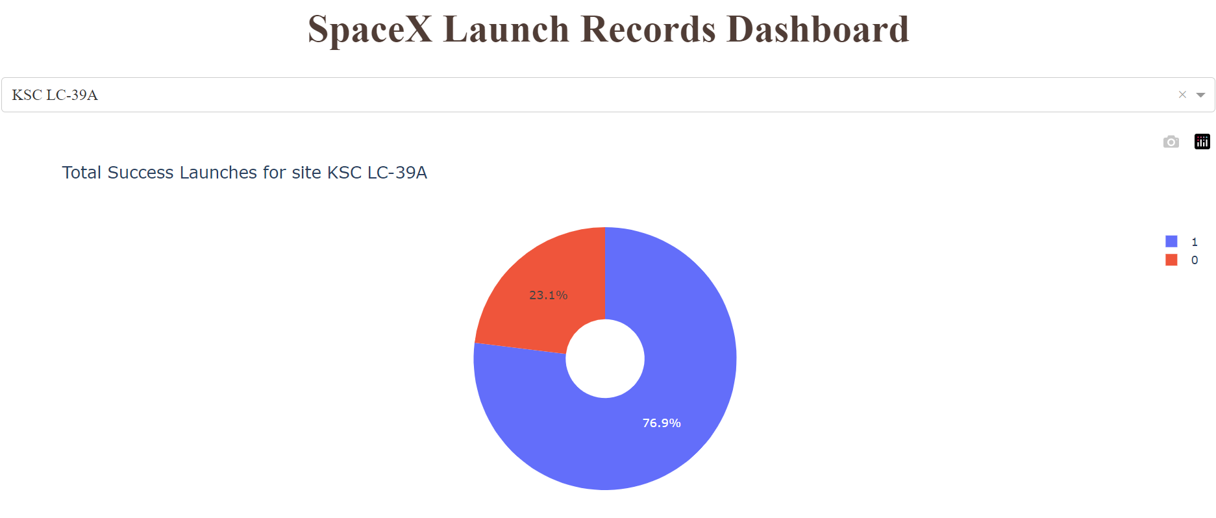
Pie Chart showing the launch site with the launch rate success ratio
KSC LC-39A achieved a launch success rate of 76.9% and a failure rate of 23.1%

Slide 41
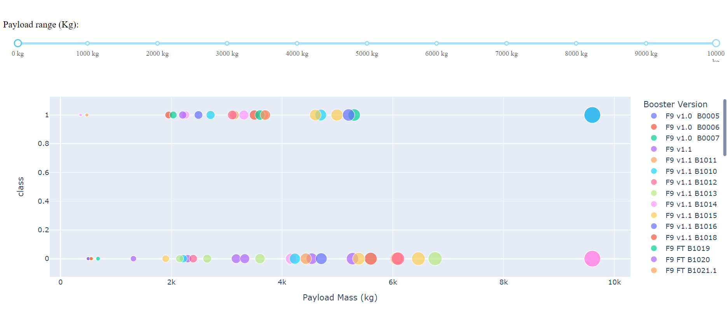
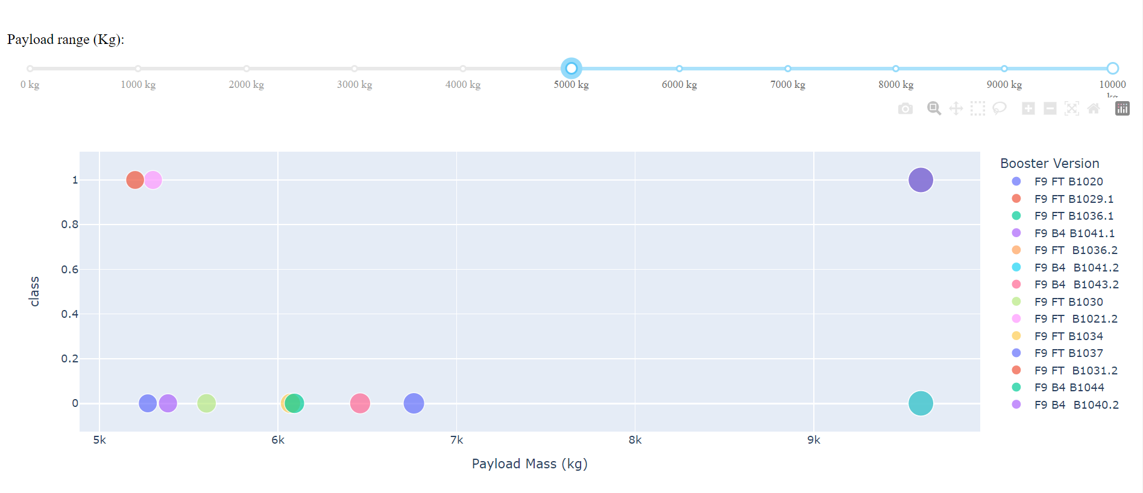
Scatter plot of Payload and Launch outcome for all Sites with different Payload
We can observe that the success of low weighted pay load is higher than that of heavy weighted pay load

Slide 42

Section 5

Slide 43
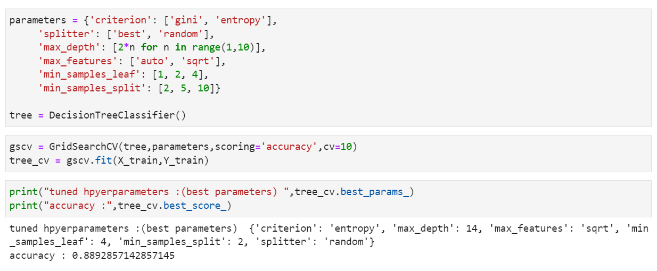
Classification Accuracy
The Decision Tree Classifier is the model with the highest accuracy score

Slide 44
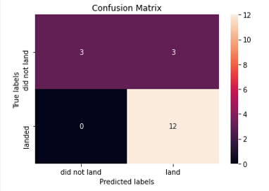
Confusion Matrix
The confusion matrix for the decision tree classifier shows that the classifier can distinguish to a high degree different classes. Though from the confusion matrix below, we can see that the classifier wrongly classified 3 unsuccessful landing to be successful.

Slide 45
Conclusions
From the analysis conducted, we can deduce that;
The larger the flight amount at the launch site, the greater the success rate at a launch site
Launch success rate started to increase from 2013 till 2020
Orbits ES-L1, GEO, HEO, SSO and VLEO have the most success rate
KSC LC-39A has the most successful launches of all launch sites
The Decision Tree Classifier is the best machine learning model for this project.

Slide 46


